Slide 1
Why ? FL
Vimalkumar Kumaresan Ph.D

Slide 3
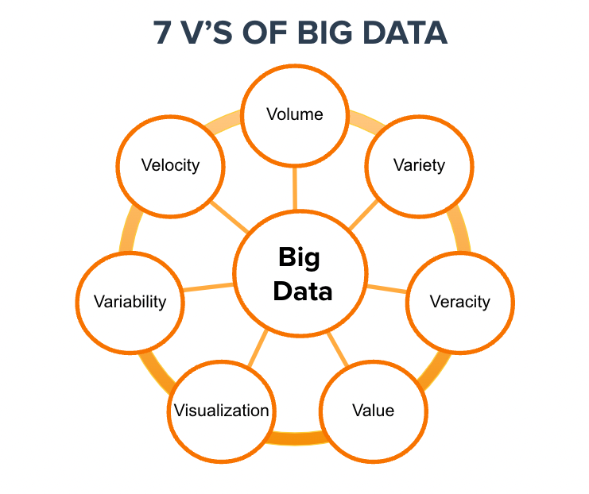
(Big) Data Characteristics

Slide 4
A³ - Mindset
Abundance of Observations
Acceptance of Messiness
Ambivalence (Contradictory) of Causality

Slide 5
Problem
Data Privacy
Expensive
Storage
Training Time
Compute
Latency
Scalability

Slide 6
Partial Solution to a Mess
Data Privacy
Data Protection Regulation
General Data Protection Regulation (GDPR)
California Consumer Privacy Act (CCPA)
From Privacy by design to data minimalism
AI Models Performance (Decrease)
Lack of data variety.
Lack of Acceptance of Messiness.
Model Biases
Model Drift
Data Drift - Train Data is significantly different from Production data.
Concept Drift - is a result of changes in how variables correlate with each other.

Slide 7
Terminology
Model Bias:
Also known as AI Bias or Algorithm Bias.
Model Drift:
Degradation of ML model performance because of changes in data
and relationships between input and output (I/O) variables, known as model decay.

Slide 8
Need in Hour
Federated Learning:
One of the most popular privacy-preserving AI technologies because private data does not have to be collected or shared with third-party entities to generate high-quality intelligence.
Learning of the data can happen anywhere; even if the data is not available for the AI service providers, all we have to do is collect and aggregate trained ML models in a consistent way.
Continuous learning Framework.

Slide 9
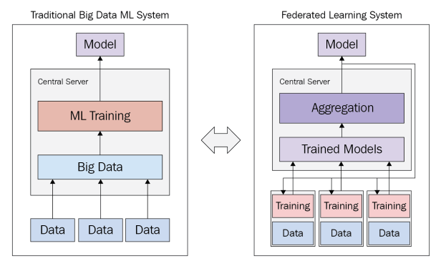
Compare

